Slide 1
DB Connection (step by step)
Visual studio 2015 and MS SQL Server 2012

Slide 2
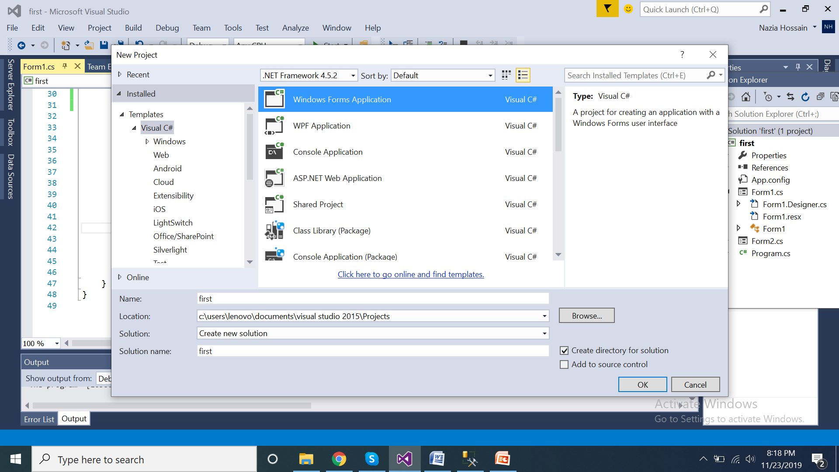
First create a C# Windows Form Application as a new project

Slide 3
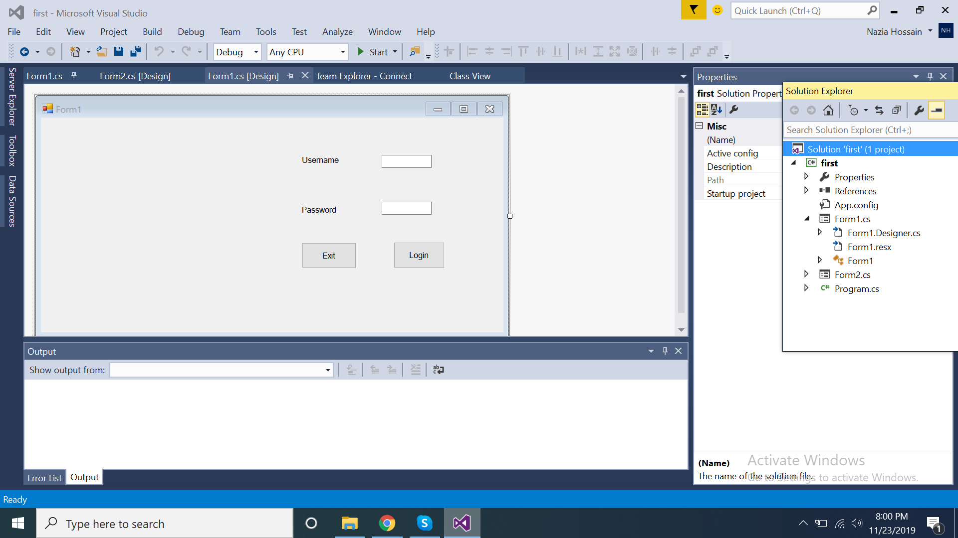
Now from the View-> Toolbox; add two textboxes, two labels and two buttons.
Then change their corresponding texts as in figure.

Slide 4
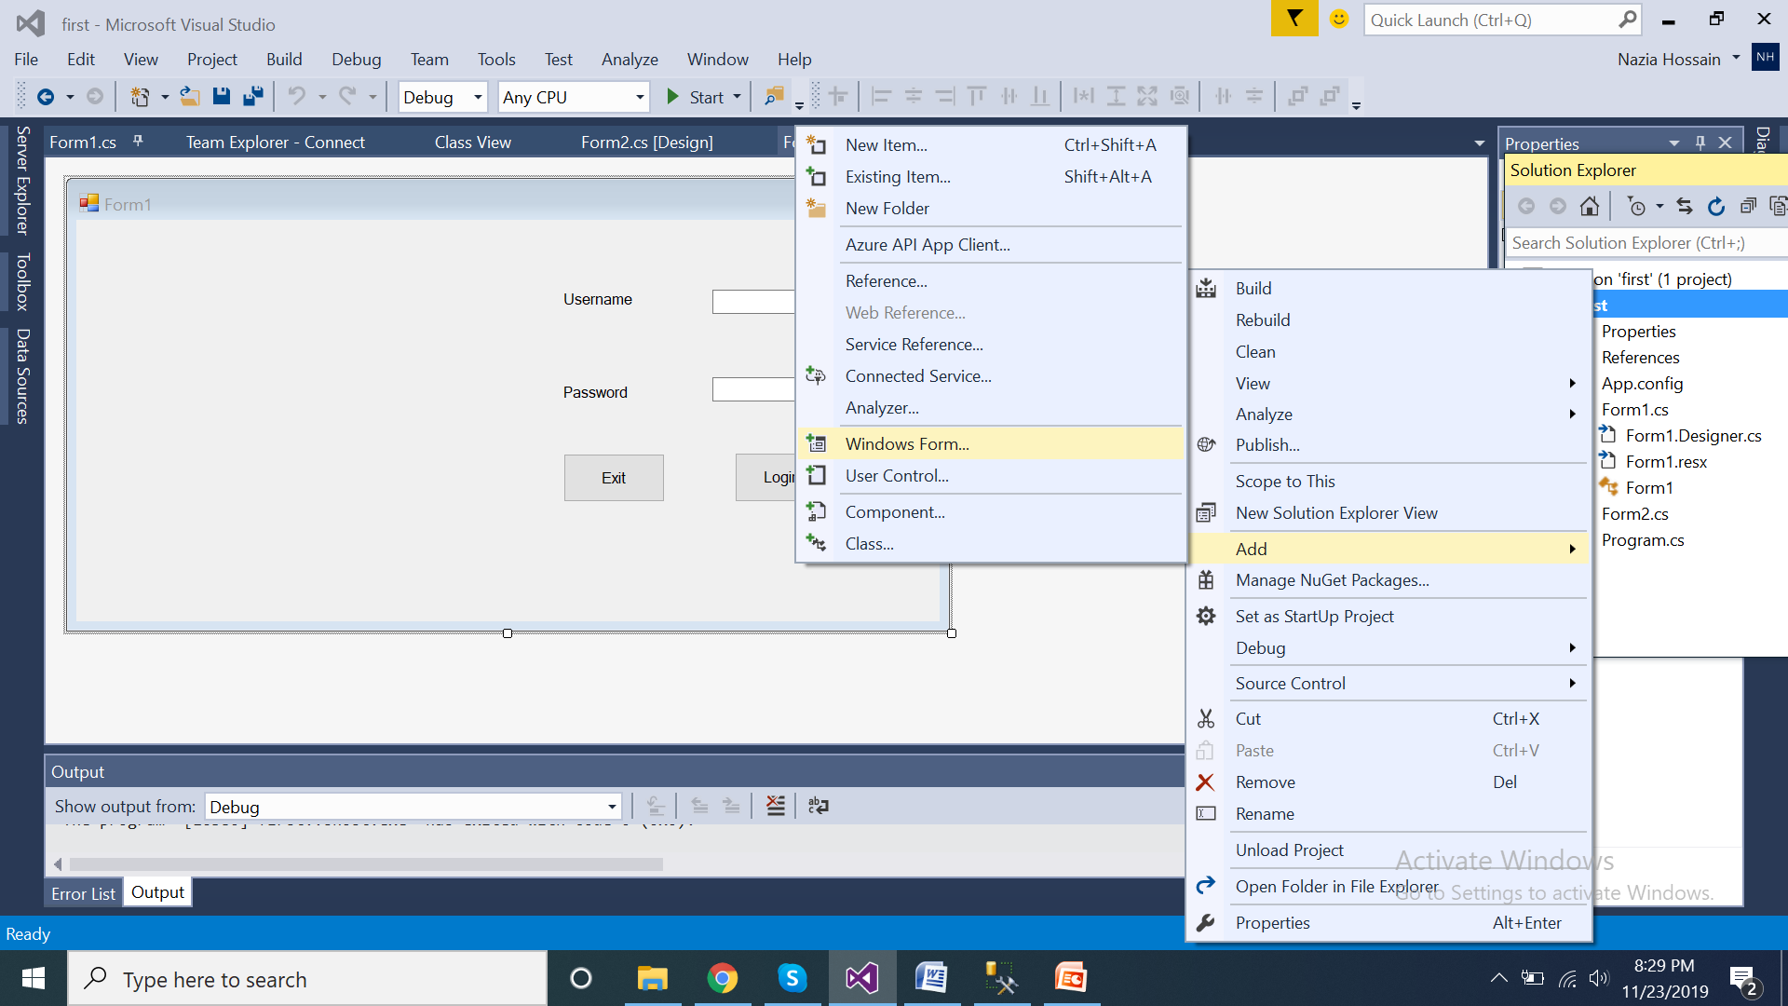
From the solution explorer->”your project” (hrere, first), create another windows form as in
Figure.

Slide 5
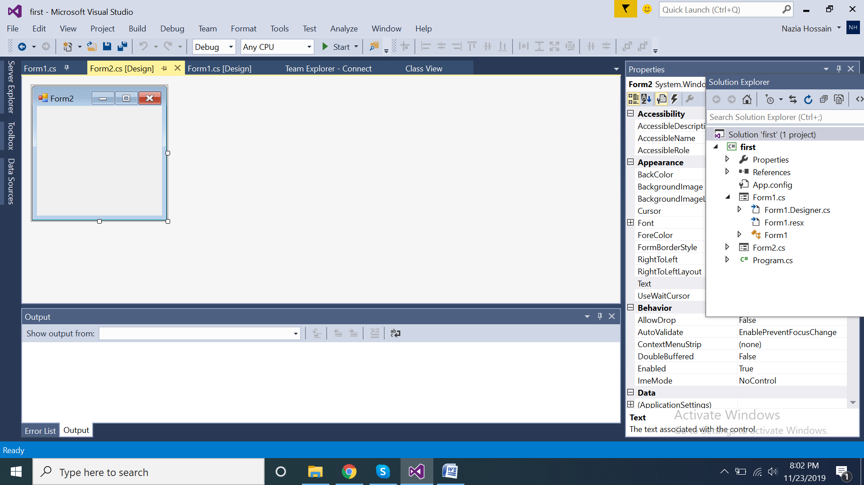
This is the new form.

Slide 6
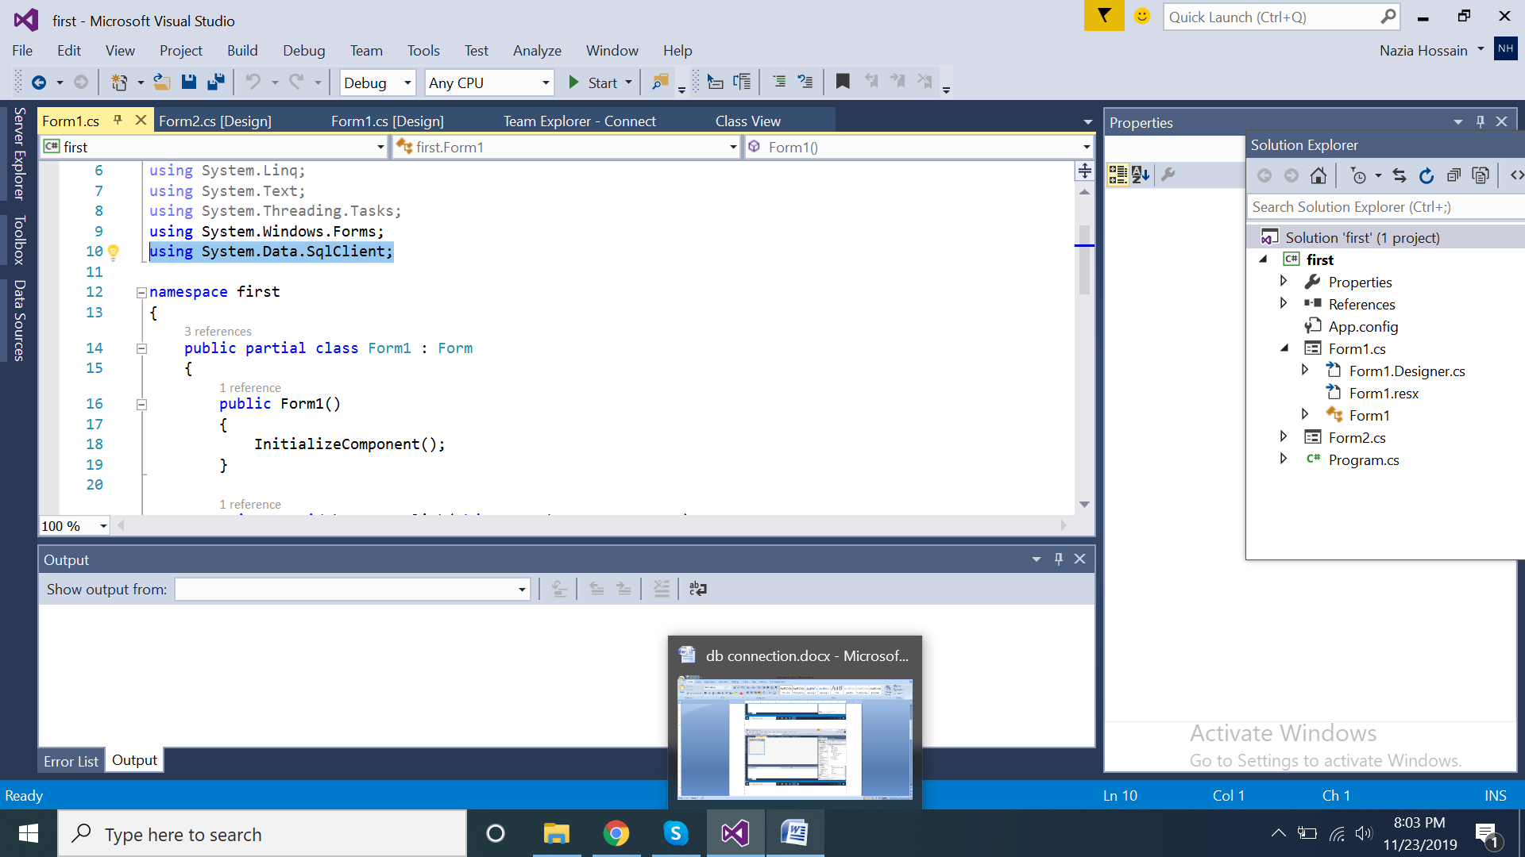
For DBMS Connection, use this class as header.

Slide 7
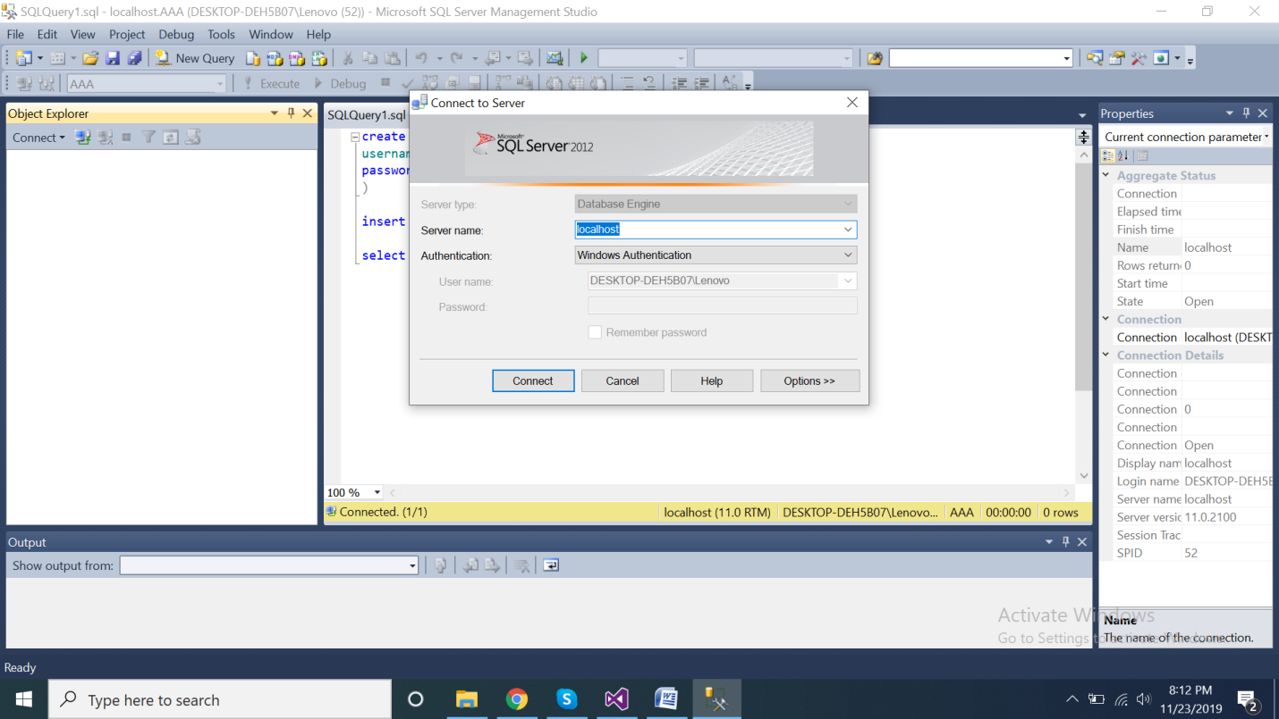
In this step, start your SQL Server

Slide 8
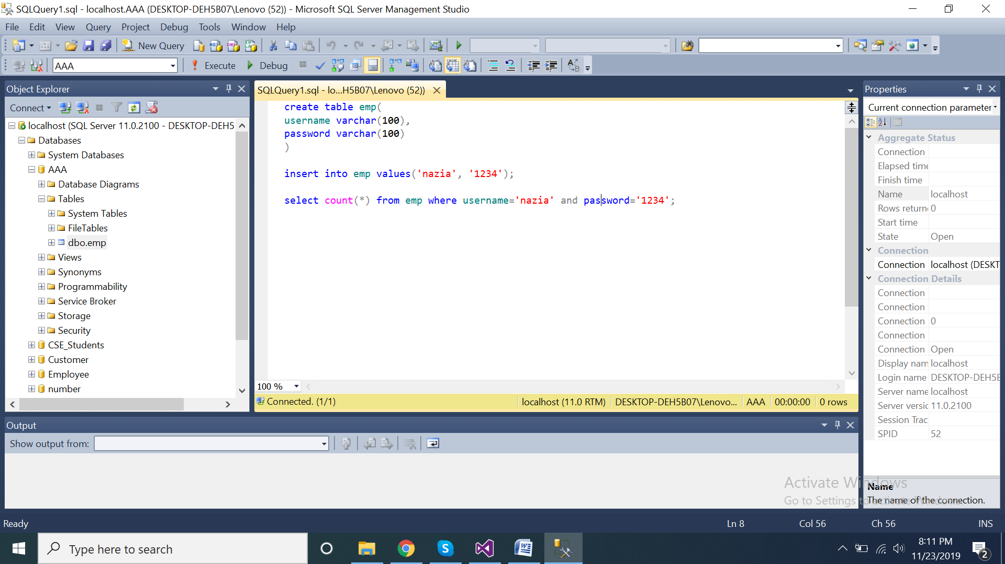
Create a database named “AAA”, and create table “emp” as
Follows in the AAA database, Insert one row with username and password.

Slide 9
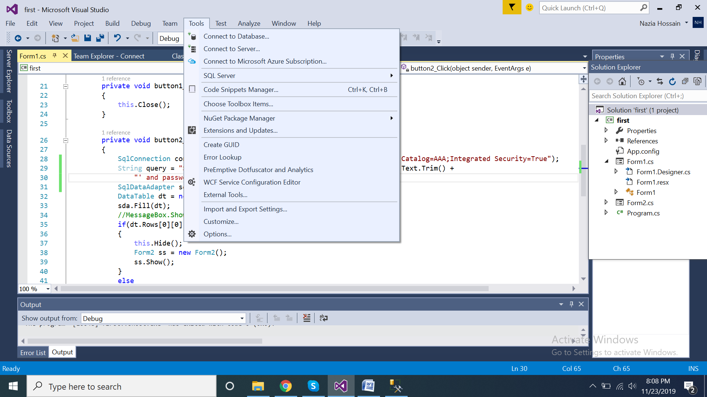
Go back to your application to connect the project with SQL Server. To do that, go to Tool->
Connect to Database

Slide 10
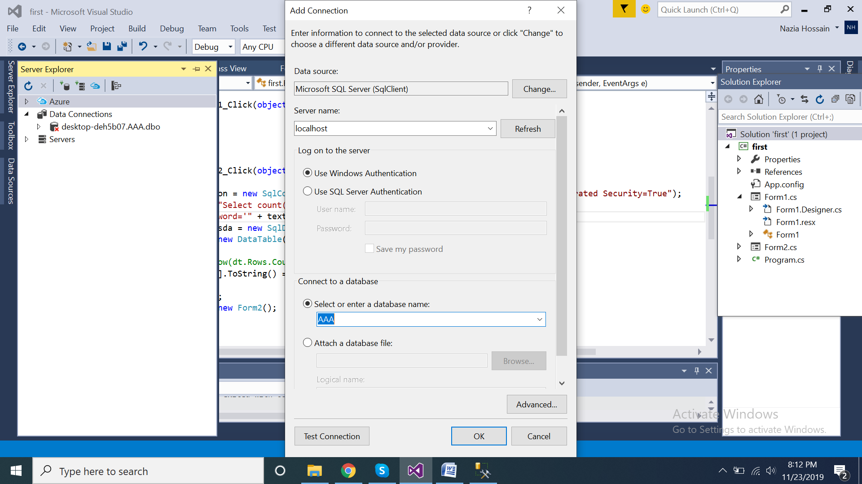
In the dialog box, Keep Data source as “Microsoft SQL Server (Client)”, as Server name write “localhost” (as my Servername is “localhost” and this is Windows authentication here). To the “Connect to a database” section write down “AAA” (as I have given my database name as “AAA”) then click “OK”. [you can also click “Test Connection” to test your connect is okay or not]

Slide 11
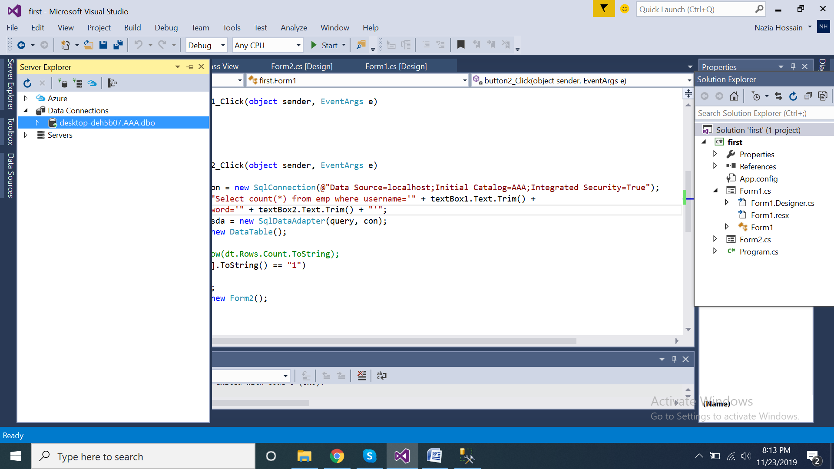
Now you will get your database in the “Data Connections” section.

Slide 12
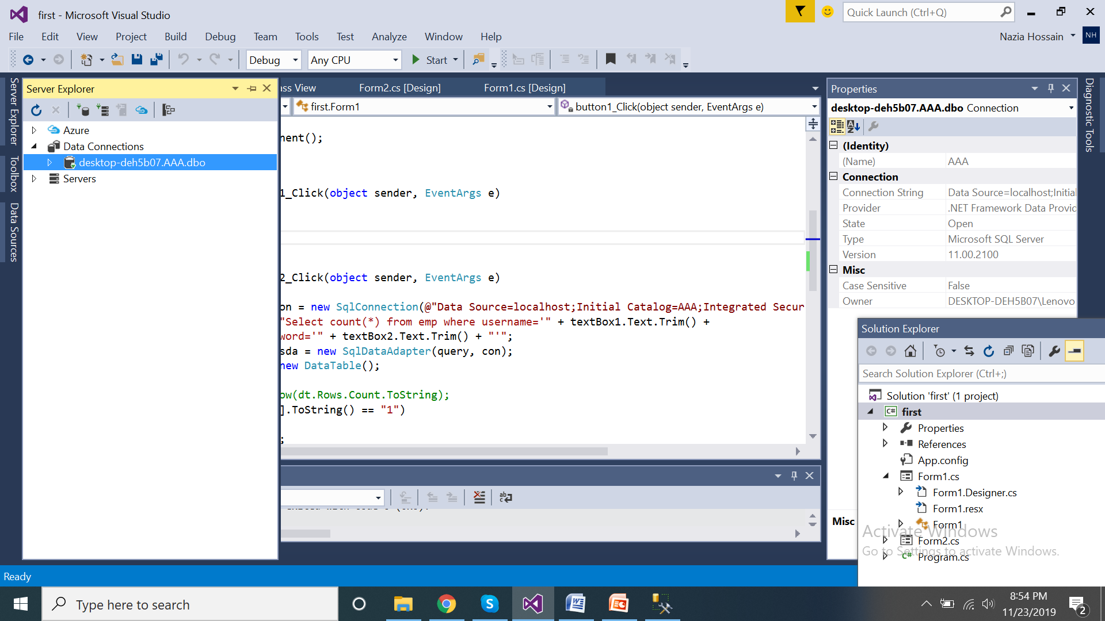
To get connection string, copy the text from “Connection”-> “Connection String” [The connection panel will appear when you will click the desired database name]

Slide 13
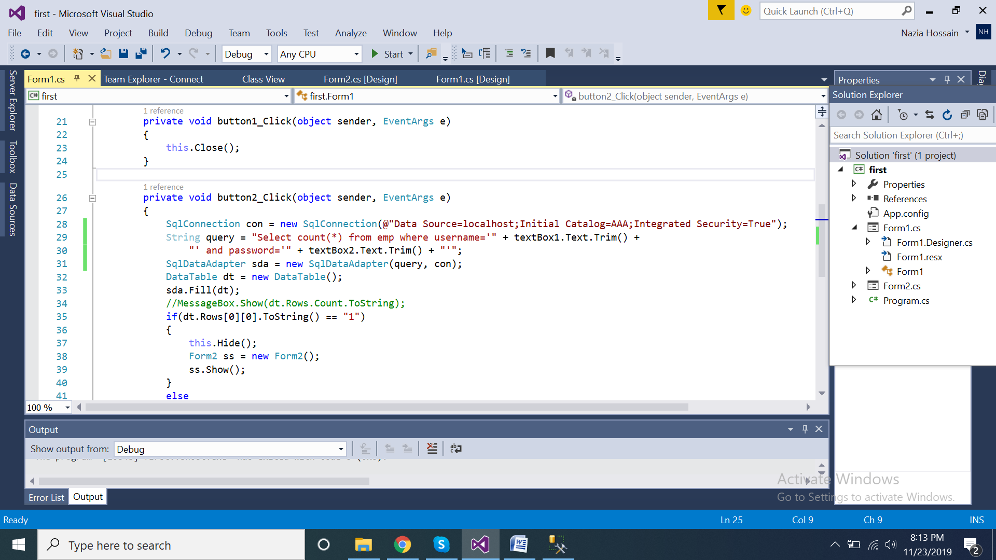
Then, write down this code in the Form1.cs under the “login button click function”. Here, my login button function name is “button2_click()”.

Slide 14
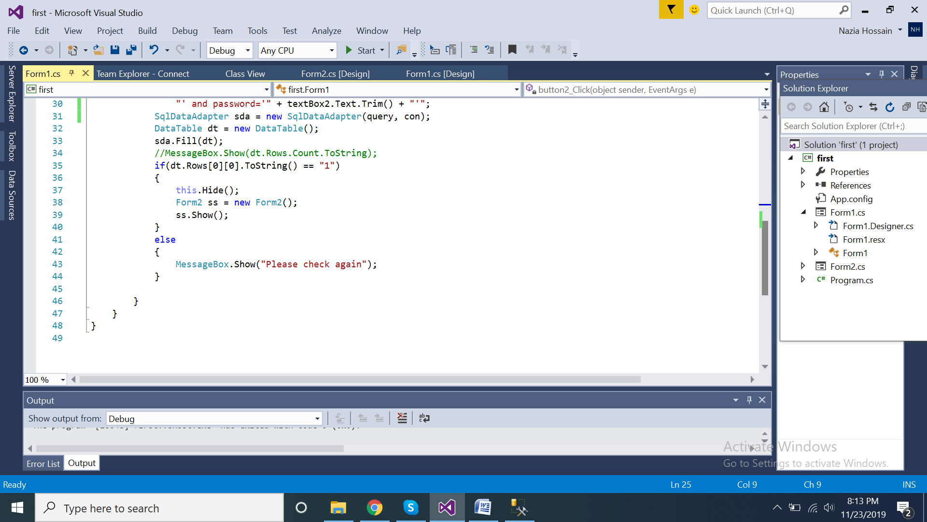
This is the rest of the code…..

Slide 15
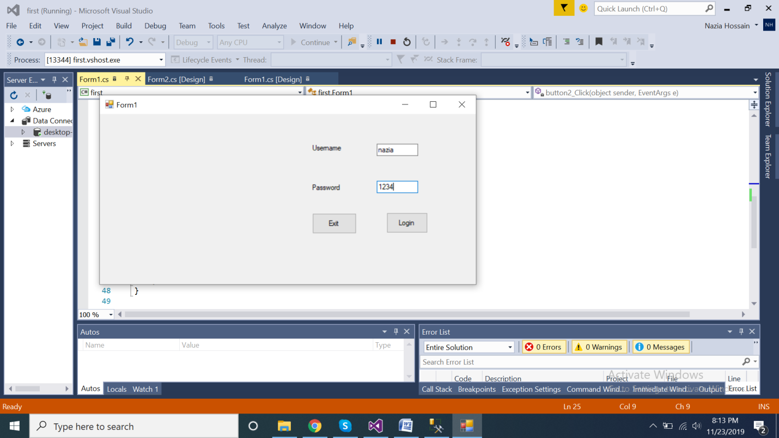
Now , start (run) your project and test the requirements.

Slide 16
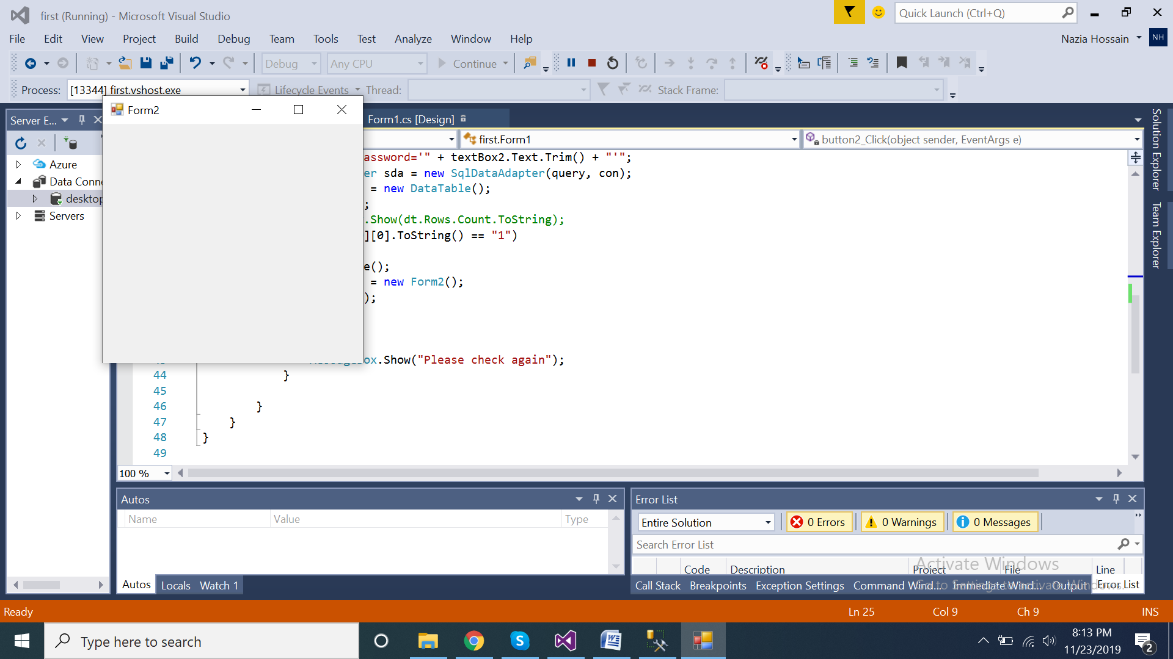
When the input is okay.

Slide 17
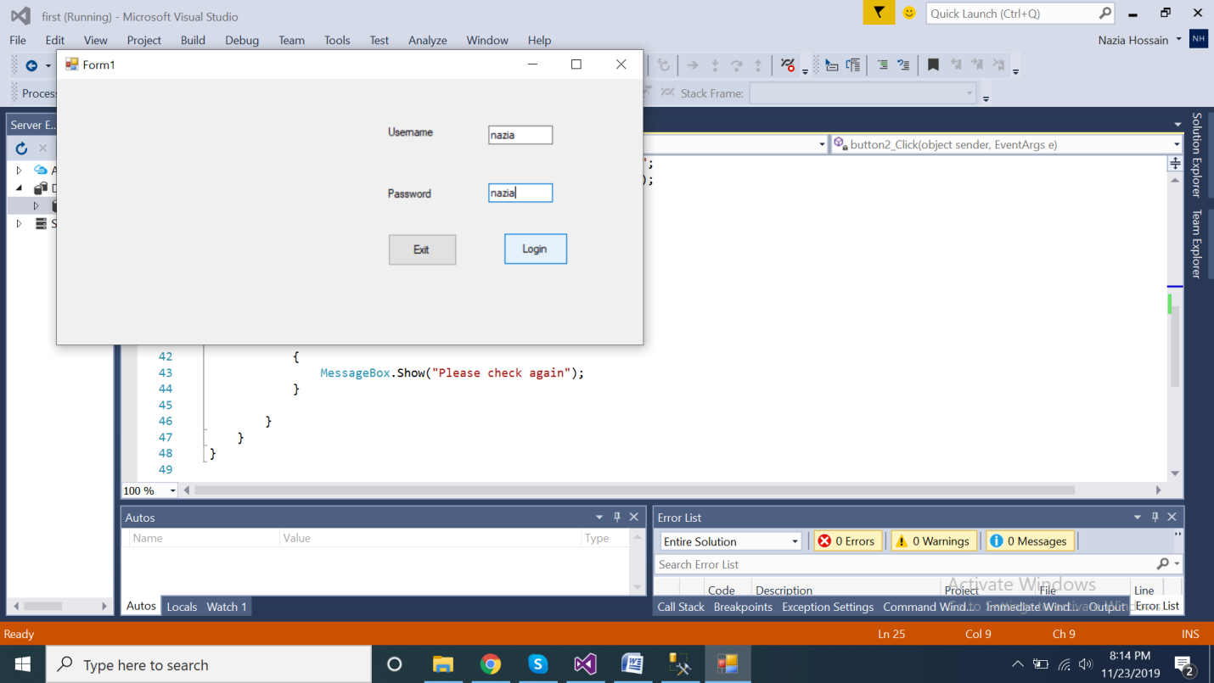
Test with wrong input.

Slide 18
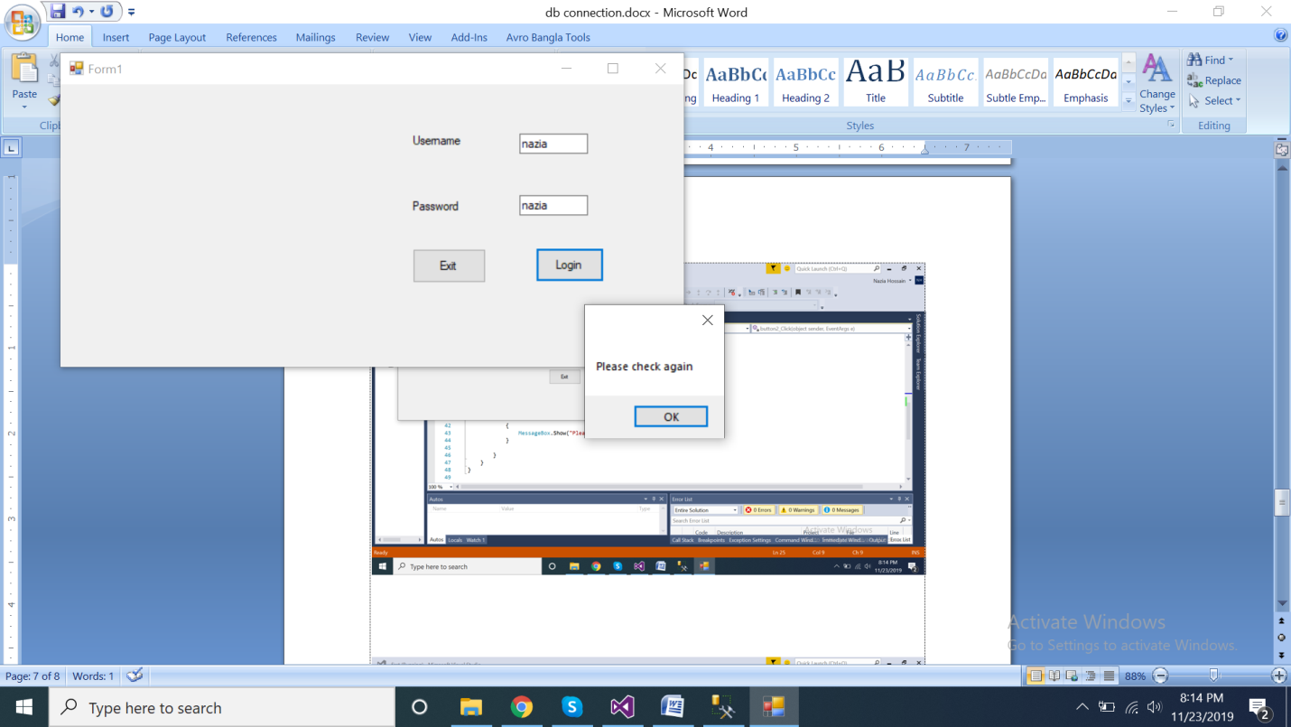
With wrong input, the warning message box is showing…

Slide 19
Reference
https://www.youtube.com/watch?v=Z_TmTLDm5Wc
https://www.youtube.com/watch?v=NX8-LhgFnUU

Slide 20
Have fun with SQL and C#!!

